Slide 1



Noida Institute of Engineering and Technology, Greater Noida
REINFORCEMENT LEARNING & CASE STUDIES
Unit: 5
MACHINE LEARNING
ACSML0501
Ms. Sonia Arora
Assistant Professor
CSBS Department
B Tech 5TH Sem
Computer Science and Engineering (DATA SCIENCE)

Slide 2
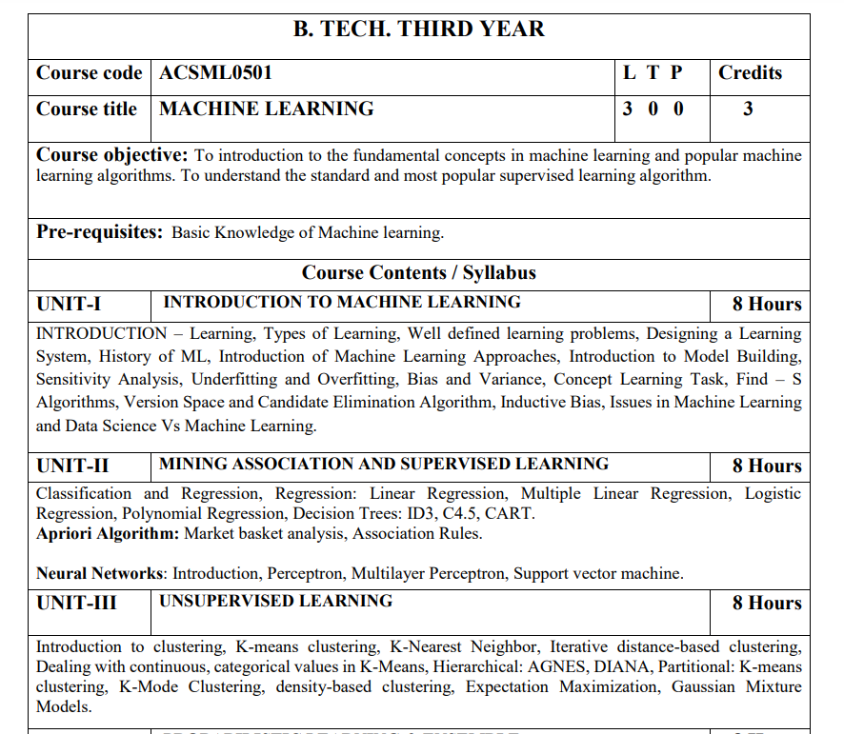
Subject Syllabus

Slide 3
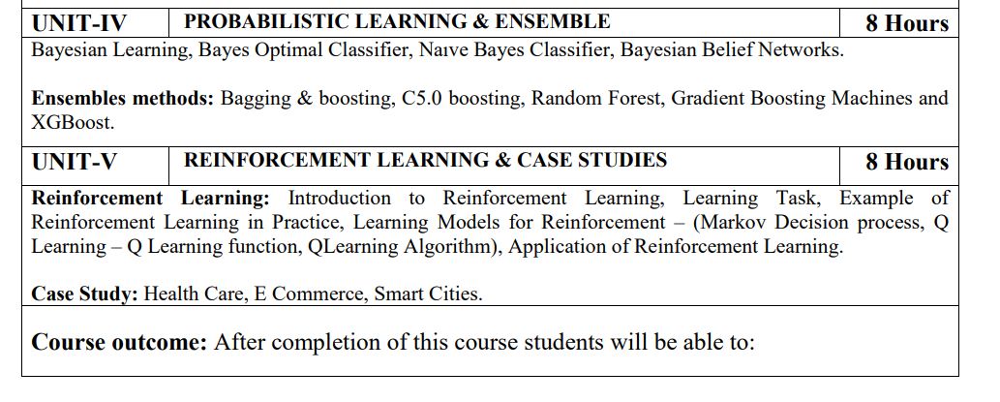
Subject Syllabus
MS. Sonia Arora ACSML0501 Machine Learning Unit 5

Slide 4
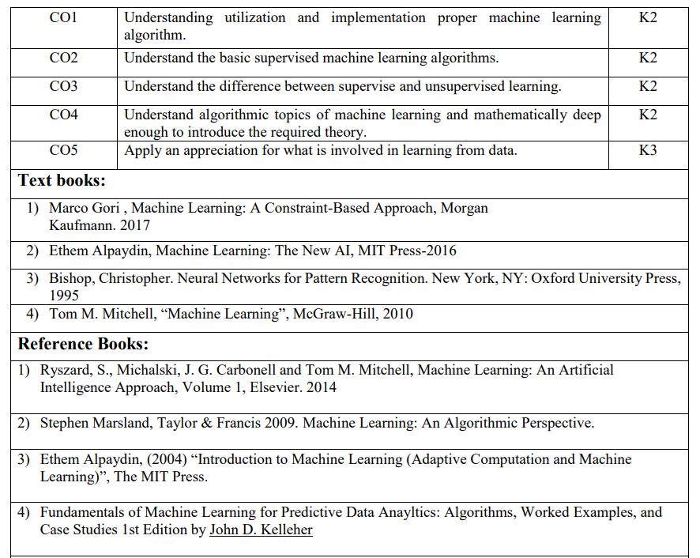
Text Books
MS. Sonia Arora ACSML0501 Machine Learning Unit 5

Slide 5
Branch Wise Applications
1. Robotics: Teaching robots to perform tasks like navigation, manipulation, and control.
2. Game Playing: Training agents to play games like Go, Poker, and Video Games.
3. Recommendation Systems: Personalizing recommendations for users based on their behavior.
4. Autonomous Vehicles: Training vehicles to make decisions while driving.
5. Fraud Detection: Identifying fraudulent transactions using machine learning models.
MS. Sonia Arora ACSML0501 Machine Learning Unit 5

Slide 6
Result Analysis
ML Result of 2021-22: 96.00%
ML Result of 2022-23: 95.80%

Slide 7
Prerequisite
Prerequisites:
Statistics.
Linear Algebra.
Calculus.
Probability.
Programming Languages.
MS. Sonia Arora ACSML0501 Machine Learning Unit 5

Slide 8
Brief Introduction
Reinforcement Learning (RL):
An AI technique where an agent learns to make decisions by interacting with an environment, aiming to maximize rewards and improve its behavior over time.
https://www.youtube.com/watch?v=3yJTInvfQvw&pp=ygUWUmVpbmZvcmNlbWVudCBMZWFybmluZw%3D%3D
https://www.youtube.com/watch?v=PIfj8jJuO1s&pp=ygUWUmVpbmZvcmNlbWVudCBMZWFybmluZw==

Slide 9
Unit 5 Content
Introduction to Reinforcement Learning,
Learning Task,
Example of Reinforcement Learning in Practice
Learning Models for Reinforcement
Markov Decision process
Q Learning – Q Learning function,
Q Learning Algorithm
Application of Reinforcement Learning
Case Study: Health Care, E Commerce, Smart Cities.

Slide 10
Unit Objective
The objective of the Unit 5
Conceptualization and summarization of reinforcement learning: To introduce students to the learning tasks and techniques with the help of example based on game (Q learning).

Slide 11
Topic Objective
The objective of the topic is to make the student able to understand about :
Reinforcement learning.
Recap
Students learnt the Reinforcement learning.

Slide 12
REINFORCEMENT LEARNING
Reinforcement Learning is a feedback-based Machine learning technique in which an agent learns to behave in an environment by performing the actions and seeing the results of actions. For each good action, the agent gets positive feedback, and for each bad action, the agent gets negative feedback or penalty.
In Reinforcement Learning, the agent learns automatically using feedbacks without any labeled data, unlike supervised learning.
Since there is no labeled data, so the agent is bound to learn by its experience only.
RL solves a specific type of problem where decision making is sequential, and the goal is long-term, such as game-playing, robotics, etc.

Slide 13
REINFORCEMENT LEARNING
The agent interacts with the environment and explores it by itself. The primary goal of an agent in reinforcement learning is to improve the performance by getting the maximum positive rewards.
The agent learns with the process of hit and trial, and based on the experience, it learns to perform the task in a better way. Hence, we can say that "Reinforcement learning is a type of machine learning method where an intelligent agent (computer program) interacts with the environment and learns to act within that." How a Robotic dog learns the movement of his arms is an example of Reinforcement learning.

Slide 14
REINFORCEMENT LEARNING
There are mainly two types of reinforcement learning, which are:
Positive Reinforcement
Negative Reinforcement
Positive Reinforcement:
The positive reinforcement learning means adding something to increase the tendency that expected behavior would occur again. It impacts positively on the behavior of the agent and increases the strength of the behavior.
This type of reinforcement can sustain the changes for a long time, but too much positive reinforcement may lead to an overload of states that can reduce the consequences.

Slide 15
REINFORCEMENT LEARNING
2. Negative Reinforcement:
The negative reinforcement learning is opposite to the positive reinforcement as it increases the tendency that the specific behavior will occur again by avoiding the negative condition.
It can be more effective than the positive reinforcement depending on situation and behavior, but it provides reinforcement only to meet minimum behavior.

Slide 16
Topic Objective
The objective of the topic is to make the student able to understand about :
Approaches to Reinforcement learning.
Recap
Students learnt the Reinforcement learning

Slide 17
APPROACHES TO IMPLEMENT REINFORCEMENT LEARNING
There are mainly three ways to implement reinforcement-learning in ML, which are:
Value-based:
The value-based approach is about to find the optimal value function, which is the maximum value at a state under any policy. Therefore, the agent expects the long-term return at any state(s) under policy π.
2. Policy-based:
Policy-based approach is to find the optimal policy for the maximum future rewards without using the value function. In this approach, the agent tries to apply such a policy that the action performed in each step helps to maximize the future reward.

Slide 18
APPROACHES TO IMPLEMENT REINFORCEMENT LEARNING
The policy-based approach has mainly two types of policy:
Deterministic: The same action is produced by the policy (π) at any state.
Stochastic: In this policy, probability determines the produced action.
3. Model-based: In the model-based approach, a virtual model is created for the environment, and the agent explores that environment to learn it. There is no particular solution or algorithm for this approach because the model representation is different for each environment.

Slide 19
Topic Objective
The objective of the topic is to make the student able to understand about :
Working of Reinforcement learning.
Recap
Students learnt the Approaches to Reinforcement learning

Slide 20
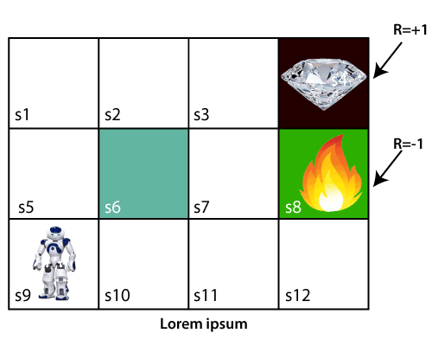
WORKING REINFORCEMENT LEARNING
The working process of the RL, we need to consider two main things:
Environment: It can be anything such as a room, maze, football ground, etc.
Agent: An intelligent agent such as AI robot.
Let's take an example of a maze environment that the agent needs to explore. Consider the below image:

Slide 21
WORKING REINFORCEMENT LEARNING
In the above image, the agent is at the very first block of the maze. The maze is consisting of an S₆ block, which is a wall, S₈ a fire pit, and S₄ a diamond block.
The agent cannot cross the S₆ block, as it is a solid wall. If the agent reaches the S₄ block, then get the +1 reward; if it reaches the fire pit, then gets -1 reward point. It can take four actions: move up, move down, move left, and move right.
The agent can take any path to reach to the final point, but he needs to make it in possible fewer steps. Suppose the agent considers the path S9-S5-S1-S2-S3, so he will get the +1-reward point.

Slide 22
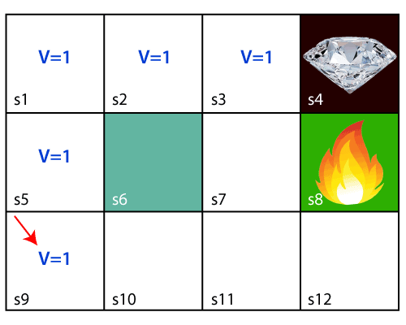
WORKING REINFORCEMENT LEARNING
The agent will try to remember the preceding steps that it has taken to reach the final step. To memorize the steps, it assigns 1 value to each previous step.
Consider the below step:

Slide 23
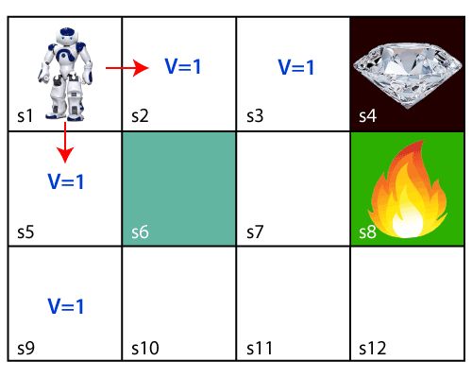
WORKING REINFORCEMENT LEARNING
Now, the agent has successfully stored the previous steps assigning the 1 value to each previous block. But what will the agent do if he starts moving from the block, which has 1 value block on both sides?
Consider the below diagram:

Slide 24
WORKING REINFORCEMENT LEARNING
It will be a difficult condition for the agent whether he should go up or down as each block has the same value. So, the above approach is not suitable for the agent to reach the destination.
Hence to solve the problem, we will use the Bellman equation, which is the main concept behind reinforcement learning.

Slide 25
Topic Objective
The objective of the topic is to make the student able to understand about :
Bellman equation Reinforcement learning algorithm.
Recap
Students learnt the working of Reinforcement learning

Slide 26
BELLMAN’s EQUATION
The Bellman equation was introduced by the Mathematician Richard Ernest Bellman in the year 1953, and hence it is called as a Bellman equation.
It is associated with dynamic programming and used to calculate the values of a decision problem at a certain point by including the values of previous states.
It is a way of calculating the value functions in dynamic programming or environment that leads to modern reinforcement learning.

Slide 27
BELLMAN’s EQUATION
The key-elements used in Bellman equations are:
Action performed by the agent is referred to as "a"
State occurred by performing the action is "s."
The reward/feedback obtained for each good and bad action is "R."
A discount factor is Gamma "γ.“
The Bellman equation can be written as:
V(s) = max [R(s,a) + γV(s`)]
Where,
V(s)= value calculated at a particular point.
R(s,a) = Reward at a particular state s by performing an action.
γ = Discount factor
V(s`) = The value at the previous state.

Slide 28
BELLMAN’s EQUATION
Using the Bellman equation, we will find value at each state of the given environment. We will start from the block, which is next to the target block.
For 1st block:
V(s3) = max [R(s,a) + γV(s`)], here V(s')= 0 because there is no further state to move.
V(s3)= max[R(s,a)]=> V(s3)= max[1]=> V(s3)= 1.
For 2nd block:
V(s2) = max [R(s,a) + γV(s`)], here γ= 0.9(lets), V(s')= 1, and R(s, a)= 0, because there is no reward at this state.
V(s2)= max[0.9(1)]=> V(s)= max[0.9]=> V(s2) =0.9

Slide 29
BELLMAN’s EQUATION
For 3rd block:
V(s1) = max [R(s,a) + γV(s`)], here γ= 0.9(lets), V(s')= 0.9, and R(s, a)= 0, because there is no reward at this state also.
V(s1)= max[0.9(0.9)]=> V(s3)= max[0.81]=> V(s1) =0.81
For 4th block:
V(s5) = max [R(s,a) + γV(s`)], here γ= 0.9(lets), V(s')= 0.81, and R(s, a)= 0, because there is no reward at this state also.
V(s5)= max[0.9(0.81)]=> V(s5)= max[0.81]=> V(s5) =0.73
For 5th block:
V(s9) = max [R(s,a) + γV(s`)], here γ= 0.9(lets), V(s')= 0.73, and R(s, a)= 0, because there is no reward at this state also.
V(s9)= max[0.9(0.73)]=> V(s4)= max[0.81]=> V(s4) =0.66

Slide 30
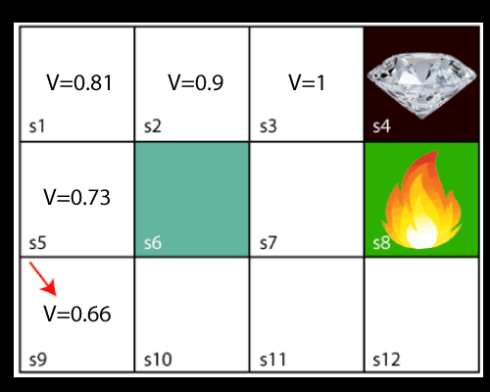
BELLMAN’s EQUATION
Consider the below image:
Now, we will move further to the 6th block, and here agent may change the route because it always tries to find the optimal path. So now, let's consider from the block next to the fire pit.

Slide 31
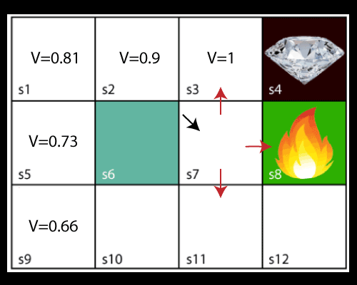
BELLMAN’s EQUATION
Now, the agent has three options to move; if he moves to the blue box, then he will feel a bump if he moves to the fire pit, then he will get the -1 reward. But here we are taking only positive rewards, so for this, he will move to upwards only. The complete block values will be calculated using this formula.

Slide 32
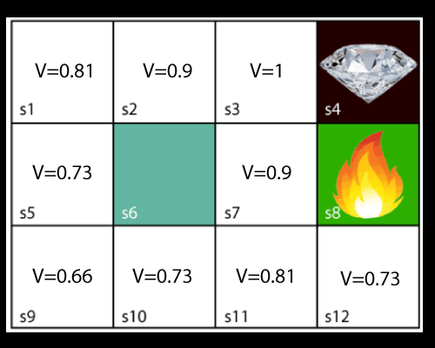
BELLMAN’s EQUATION
Consider the below image:

Slide 33
Topic Objective
The objective of the topic is to make the student able to understand about :
Markov Decision Process .
Recap
Students learnt the Bellman equation

Slide 34
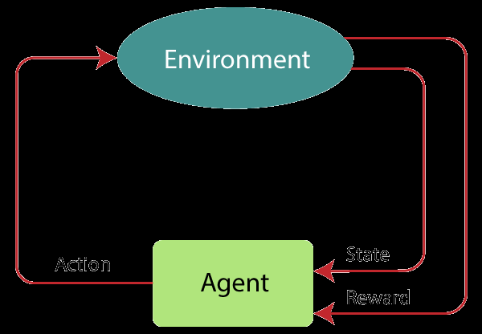
MARKOV DECISION PROCESS
Markov Decision Process or MDP, is used to formalize the reinforcement learning problems.
If the environment is completely observable, then its dynamic can be modeled as a Markov Process.
In MDP, the agent constantly interacts with the environment and performs actions; at each action, the environment responds and generates a new state.

Slide 35
MARKOV DECISION PROCESS
MDP is used to describe the environment for the RL, and almost all the RL problem can be formalized using MDP.
MDP contains a tuple of four elements (S, A, P_{a}, R_{a}):
A set of finite States S
A set of finite Actions A
Rewards received after transitioning from state S to state S', due to action a.
Probability P_{a}.

Slide 36
Topic Objective
The objective of the topic is to make the student able to understand about :
Markov Decision Property.
Recap
Students learnt the Markov Decision Process

Slide 37
MARKOV PROPERTY
It says that "If the agent is present in the current state S1, performs an action a1 and move to the state s2, then the state transition from s1 to s2 only depends on the current state and future action and states do not depend on past actions, rewards, or states.“
Or, in other words, as per Markov Property, the current state transition does not depend on any past action or state. Hence, MDP is an RL problem that satisfies the Markov property. Such as in a Chess game, the players only focus on the current state and do not need to remember past actions or states.
Finite MDP:
A finite MDP is when there are finite states, finite rewards, and finite actions. In RL, we consider only the finite MDP.

Slide 38
Topic Objective
The objective of the topic is to make the student able to understand about :
Reinforcement learning algorithm – Q learning
Recap
Students learnt the Markov Property

Slide 39
Q- LEARNING
Reinforcement learning algorithms are mainly used in AI applications and gaming applications.
The main used algorithms are:
Q-Learning:
Q-learning is an Off policy RL algorithm, which is used for the temporal difference Learning. The temporal difference learning methods are the way of comparing temporally successive predictions.
The Q stands for quality in Q-learning, which means it specifies the quality of an action taken by the agent.
It learns the value function Q (S, a), which means how good to take action "a" at a particular state "s."

Slide 40
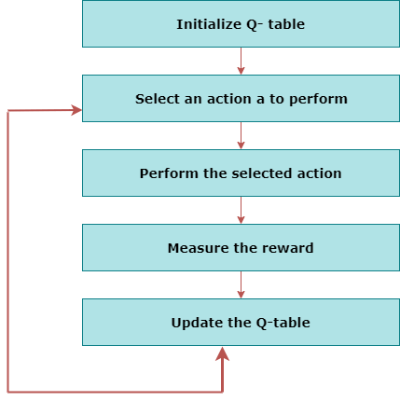
Q- LEARNING

Slide 41

Q-LEARNING
Q-learning is a popular model-free reinforcement learning algorithm based on the Bellman equation.
The main objective of Q-learning is to learn the policy which can inform the agent that what actions should be taken for maximizing the reward under what circumstances.
It is an off-policy RL that attempts to find the best action to take at a current state.
The goal of the agent in Q-learning is to maximize the value of Q.
The value of Q-learning can be derived from the Bellman equation.

Slide 42
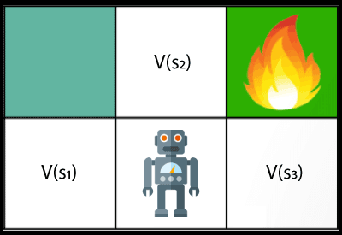
Q-LEARNING
In the equation, we have various components, including reward, discount factor (γ), probability, and end states s'. But there is no any Q-value is given so first consider the below image:

Slide 43
Q-LEARNING
In the above image, we can see there is an agent who has three values options, V(s₁), V(s₂), V(s₃). As this is MDP, so agent only cares for the current state and the future state. The agent can go to any direction (Up, Left, or Right), so he needs to decide where to go for the optimal path. Here agent will take a move as per probability bases and changes the state.
But if we want some exact moves, so for this, we need to make some changes in terms of Q-value.

Slide 44
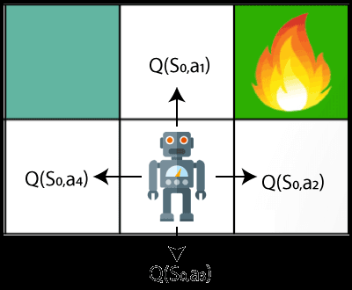
Q-LEARNING
Q- represents the quality of the actions at each state. So instead of using a value at each state, we will use a pair of state and action, i.e., Q(s, a). Q-value specifies that which action is more lubricative than others, and according to the best Q-value, the agent takes his next move.

Slide 45


Q-LEARNING
The Bellman equation can be used for deriving the Q-value.
To perform any action, the agent will get a reward R(s, a), and also he will end up on a certain state, so the Q -value equation will be:
Hence, we can say that, V(s) = max [Q(s, a)]
The above formula is used to estimate the Q-values in Q-Learning.

Slide 46
Q-Learning
Let’s say that a robot has to cross a maze and reach the end point.
There are mines, and the robot can only move one tile at a time. If
the robot steps onto a mine, the robot is dead. The robot has to
reach the end point in the shortest time possible.

Slide 47
Q-Learning
The scoring/reward system is as below:
The robot loses 1 point at each step. This is done so that the robot takes the shortest path and reaches the goal as fast as possible.
If the robot steps on a mine, the point loss is 100 and the game ends.
If the robot gets power ⚡ , it gains 1 point.
4. If the robot reaches the end goal, the robot gets 100 points.

Slide 48
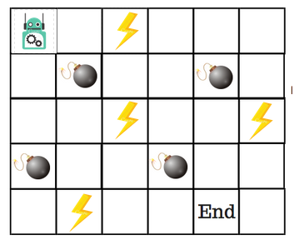
Q-Learning
End goal with the shortest path without stepping on a mine?
So, how do we solve this?

Slide 49
Q-Learning
Q-Table is just a fancy name for a simple lookup table where we
calculate the maximum expected future rewards for action at each
state. Basically, this table will guide us to the best action at each
state.
There will be four numbers of actions at each non-edge tile. When a robot is at a state it can either move up or down or right or left.

Slide 50
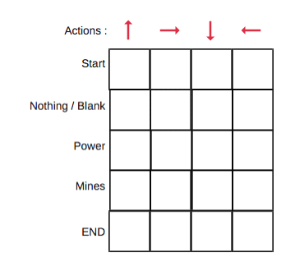
Q-Learning
So, let’s model this environment in our Q-Table. In the Q-Table,
the columns are the actions and the rows are the states.

Slide 51
Q-Learning
Each Q-table score will be the maximum expected future.
Reward that the robot will get if it takes that action at that state.
This is an iterative process, as we need to improve the Q-Table at each iteration.
But the questions are:
Are the values available or predefined?
To learn each value of the Q-table, we use the Q-Learning
algorithm.

Slide 52
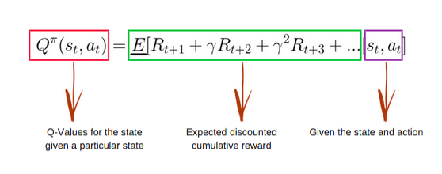
Q-Learning
The Q-function uses the Bellman equation and takes two inputs:
state (s) and action (a).

Slide 53
Q-Learning
Using the above function, we get the values of Q for the cells in the table.
When we start, all the values in the Q-table are zeros.
There is an iterative process of updating the values.
As we start to explore the environment, the Q-function gives us better and better approximations by continuously updating the Q-values in the table.

Slide 54
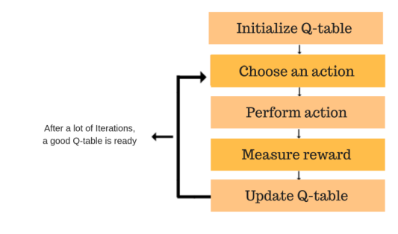
Q-Learning
Now, let’s understand how the updating takes place.
Each of the colored boxes is one step. Let’s understand each of these steps in detail.

Slide 55
Q-Learning
We will first build a Q-table.
There are n columns, where n= number of actions.
There are m rows, where m= number of states.
We will initialise the values at 0.

Slide 56
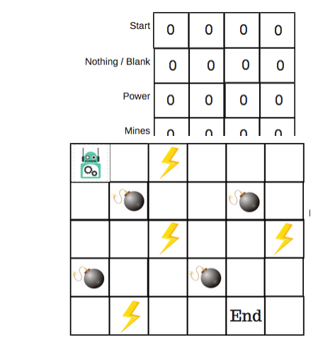
Q-Learning

Slide 57
Q-Learning
This combination of steps is done for an undefined amount of time.
This means that this step runs until the time we stop the training, or the training loop stops as defined in the code.
We will choose an action (a) in the state (s) based on the Q-Table.
But, as mentioned earlier, when the episode initially starts, every Q-value is 0.

Slide 58
Q-Learning
We’ll use something called the epsilon greedy strategy.
In the beginning, the epsilon rates will be higher.
The robot will explore the environment and randomly choose actions.
The logic behind this is that the robot does not know anything about the environment.

Slide 59
Q-Learning
As the robot explores the environment, the epsilon rate decreases and the robot starts to exploit the environment.
During the process of exploration, the robot progressively becomes more confident in estimating the Q-values.
For the robot example, there are four actions to choose from: up, down, left, and right.
We are starting the training now — our robot knows nothing about the environment. So the robot chooses a random action, say right.

Slide 60
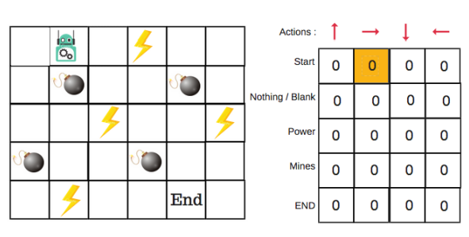
Q-Learning
We can now update the Q-values for being at the start and moving right using the Bellman equation.

Slide 61
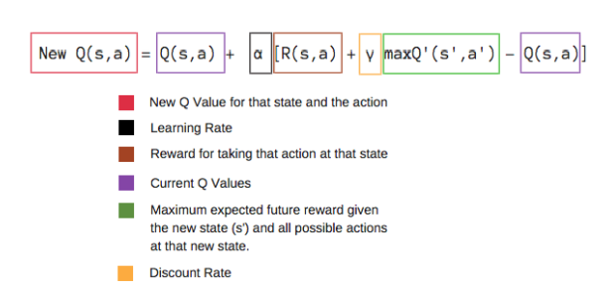
Q-Learning
Now we have taken an action and observed an outcome and
reward. We need to update the function Q(s,a).

Slide 62
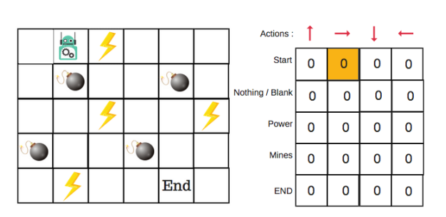
Q-Learning
In the case of the robot game, to reiterate the scoring/reward structure is:
power = +1
mine = -100
end = +100

Slide 63
Topic Objective
The objective of the topic is to make the student able to understand about :
Reinforcement learning algorithm Applications
Recap
Students learnt the Q learning algorithm

Slide 64
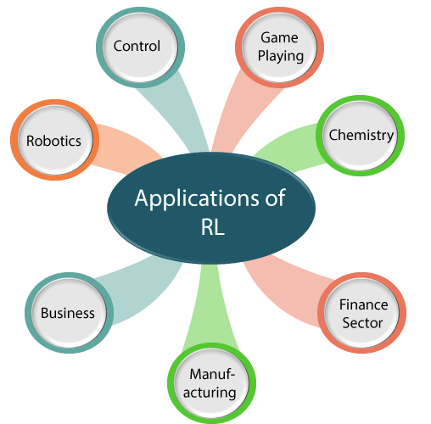
REINFORCEMENT LEARNING APPLICATIONS

Slide 65
REINFORCEMENT LEARNING APPLICATIONS
Robotics: RL is used in Robot navigation, Robo-soccer, walking, juggling, etc.
Control: RL can be used for adaptive control such as Factory processes, admission control in telecommunication, and Helicopter pilot is an example of reinforcement learning.
Game Playing: RL can be used in Game playing such as tic-tac-toe, chess, etc.
Chemistry: RL can be used for optimizing the chemical reactions.
Business: RL is now used for business strategy planning.
Manufacturing: In various automobile manufacturing companies, the robots use deep reinforcement learning to pick goods and put them in some containers.
Finance Sector: The RL is currently used in the finance sector for evaluating trading strategies.

Slide 66
Faculty Video Links, Youtube & NPTEL Video Links and Online Courses Details
Youtube/Other Video Links:
1. Machine Learning by Prof. Balaraman ravindran, Department of computer science and engineering,IIT Madras (SWAYAM/NPTEL)
https://www.youtube.com/watch?v=fC7V8QsPBec&feature=youtu.be
2. Machine Learning by Prof. Sudeshna Sarkar, Department of computer science and engineering,IIT Kharagpur (NPTEL)
https://www.youtube.com/watch?v=EWmCkVfPnJ8&list=PLlGkyYYWOSOsGU-XARWdIFsRAJQkyBrVj&index=2
3. Machine learning UPGRAD course by IIIT,Bangalore
https://www.upgrad.com/machine-learning-ai-pgd-iiitb/

Slide 67
Daily Quiz
1. Any physical event that affects a sensory cell so an individual can detect the event is called
reinforcement.
a stimulus.
a reward.
learning.

Slide 68
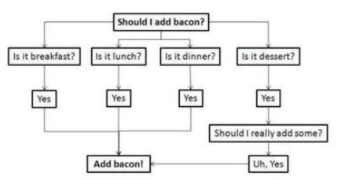
Daily Quiz
2. The data is split according to a certain requirements
Decision tree learning
Reinforcement learning
Predictive models
sentiment analysis

Slide 69
Daily Quiz
3. In the choice phase of problem solving, normative models involve selecting an optimal or best outcome
True
False
4. Analytical techniques for problem solving are best for unstructured rather than structured problems.
A. True.
B. False

Slide 70
Daily Quiz
5.Discrete events and agent-based models are usually used for middle or low levels of abstraction
True
False
6. How does blind search differ from optimization
Blind search cannot result in optimal solutions whereas optimization methods
Blind search represents a guided approach while optimization is unguided
Blind search usually does not conclude in one step like some optimization methods
Blind search is usually a more efficient problem solving approach than optimization

Slide 71
Daily Quiz
7. Which approach is most suited to complex problems with significant uncertainty, a need for experimentation, and time compression?
Simulation
Optimization
human intuition
genetic algorithms
8. In which stage of the simulation methodology do you determine the variables and gather data
Defining the problem
constructing the simulation model
testing and validating the model
designing the experiment

Slide 72
Weekly Assignment
Explain Q learning algorithm assuming deterministic rewards andaction
Describe Reduced Error Pruning
What is Rule Post Pruning
What is Reinforcement Learning?
5. Explain the Q function and Q Learning Algorithm.
6. Explain FOIL algorithm
7. Differentiate between FOIL & Sequential Covering

Slide 73
MCQ s
1. What kind of learning algorithm for "Facial identities or facial expressions"?
Recognizing Anomalies
Prediction
Generating Patterns
Recognition Patterns

Slide 74
MCQ s
2.If a single system is used for packaging, there are increased chances of endogenous material being packed. a) True b) False
3. Fitness function should be
A: maximum
B: minimum
C: intermediate
D: noneof these

Slide 75
Expected Questions for University Exam
Explain Reinforcement Learning and its applications?
Explain markov decision process?
Explain Q- learning algorithm?

Slide 76
Glossary Questions
1. Choose correct option
i)2 ii)3 iii) Positive iv)Reinforcement learning
_______is all about making decisions sequentially
_________Reinforcement is defined as when an event, occurs due to a particular behavior.
There are _______ types of reinforcement.
Reinforcement learning is one of ______ basic machine learning paradigms
2. Choose correct option
i)Reinforcement ii)Supervised learning iii)Unsupervised
-------is the machine learning algorithms that can be used with labeled data.
--------is the machine learning algorithms that can be used with labeled data.
-------- is the machine learning algorithms that can be used with self learning with environment

Slide 77
Glossary Questions
3._______operation is responsible for jumping from one hill to another hill
4._______ and ________are advantages of reinforcement learning.
5. __________algorithm is good for learning.
Q-learning, S-learning, robotics, AI, Mutation, cross over.

Slide 78
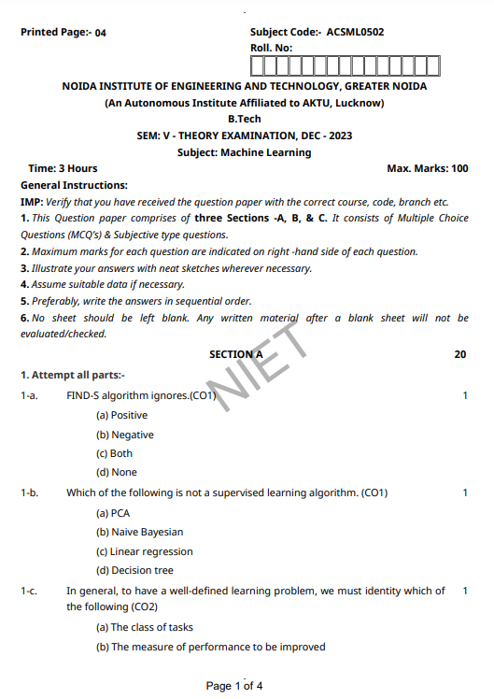
Old Question Papers

Slide 79
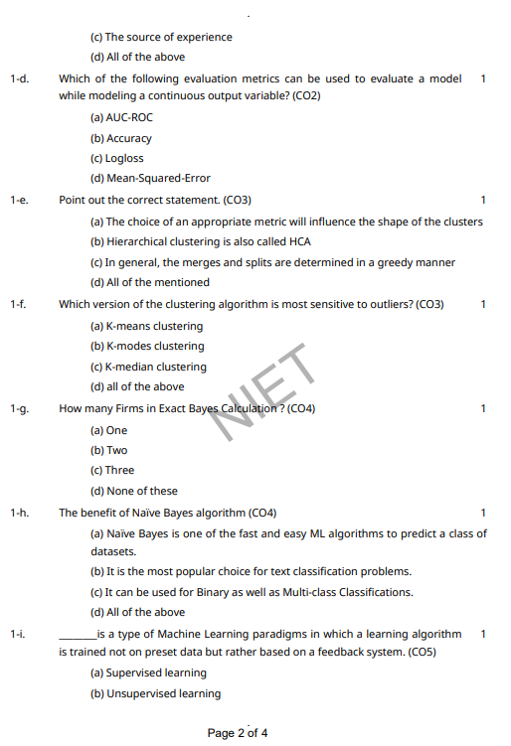
Old Question Papers

Slide 80
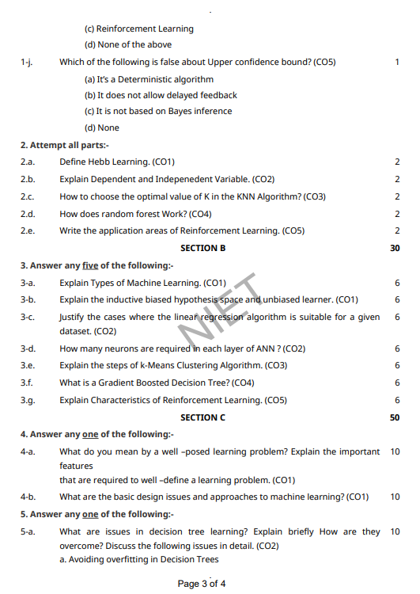
Old Question Papers

Slide 81
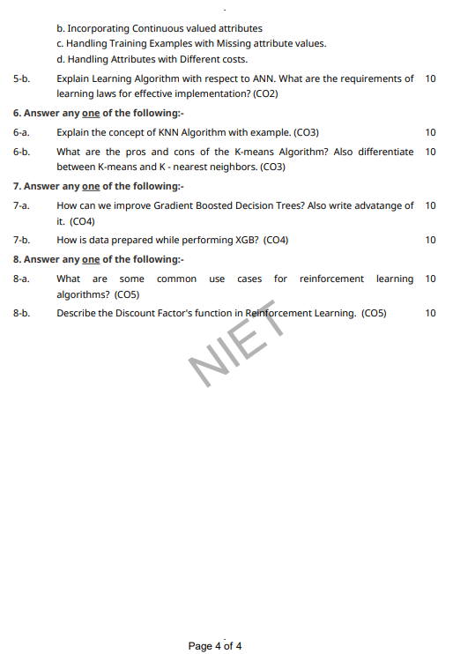
Old Question Papers

Slide 82
References
Text books:
1. Tom M. Mitchell, ―Machine Learning, McGraw-Hill Education (India) Private Limited, 2013.
2. Ethem Alpaydin, ―Introduction to Machine Learning (Adaptive Computation and Machine Learning), The MIT Press 2004.
3. Stephen Marsland, ―Machine Learning: An Algorithmic Perspective, CRC Press, 2009.
4. Bishop, C., Pattern Recognition and Machine Learning. Berlin: Springer-Verlag.

Slide 83
Recap
Reinforcement Learning
Learning Models for Reinforcement – (Markov Decision process , Q Learning - Q Learning function, Q Learning Algorithm ),
Application of Reinforcement Learning,Introduction to Deep Q Learning.

Slide 84
Thank You

